Slide 1
IIT Madras Computer Centre
P.G. Senapathy Centre for Computing Resources
DNS SERVER INSTALLATION AND TESTING
September 2026

Slide 2
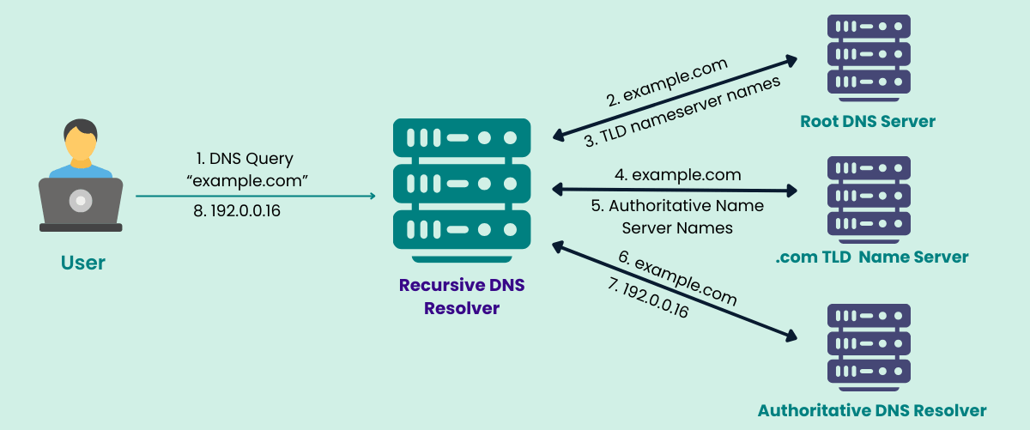

DNS Server Implementation
Configured and validated DNS resolution with a ping test
A DNS server is a network server that translates human-readable domain names into IP addresses, allowing computers to locate services on a network.
Port: 53
You → www.google.com → DNS Server → Finds IP Address → 142.250.xxx.xxx → Google Server → Website Displayed

Slide 3
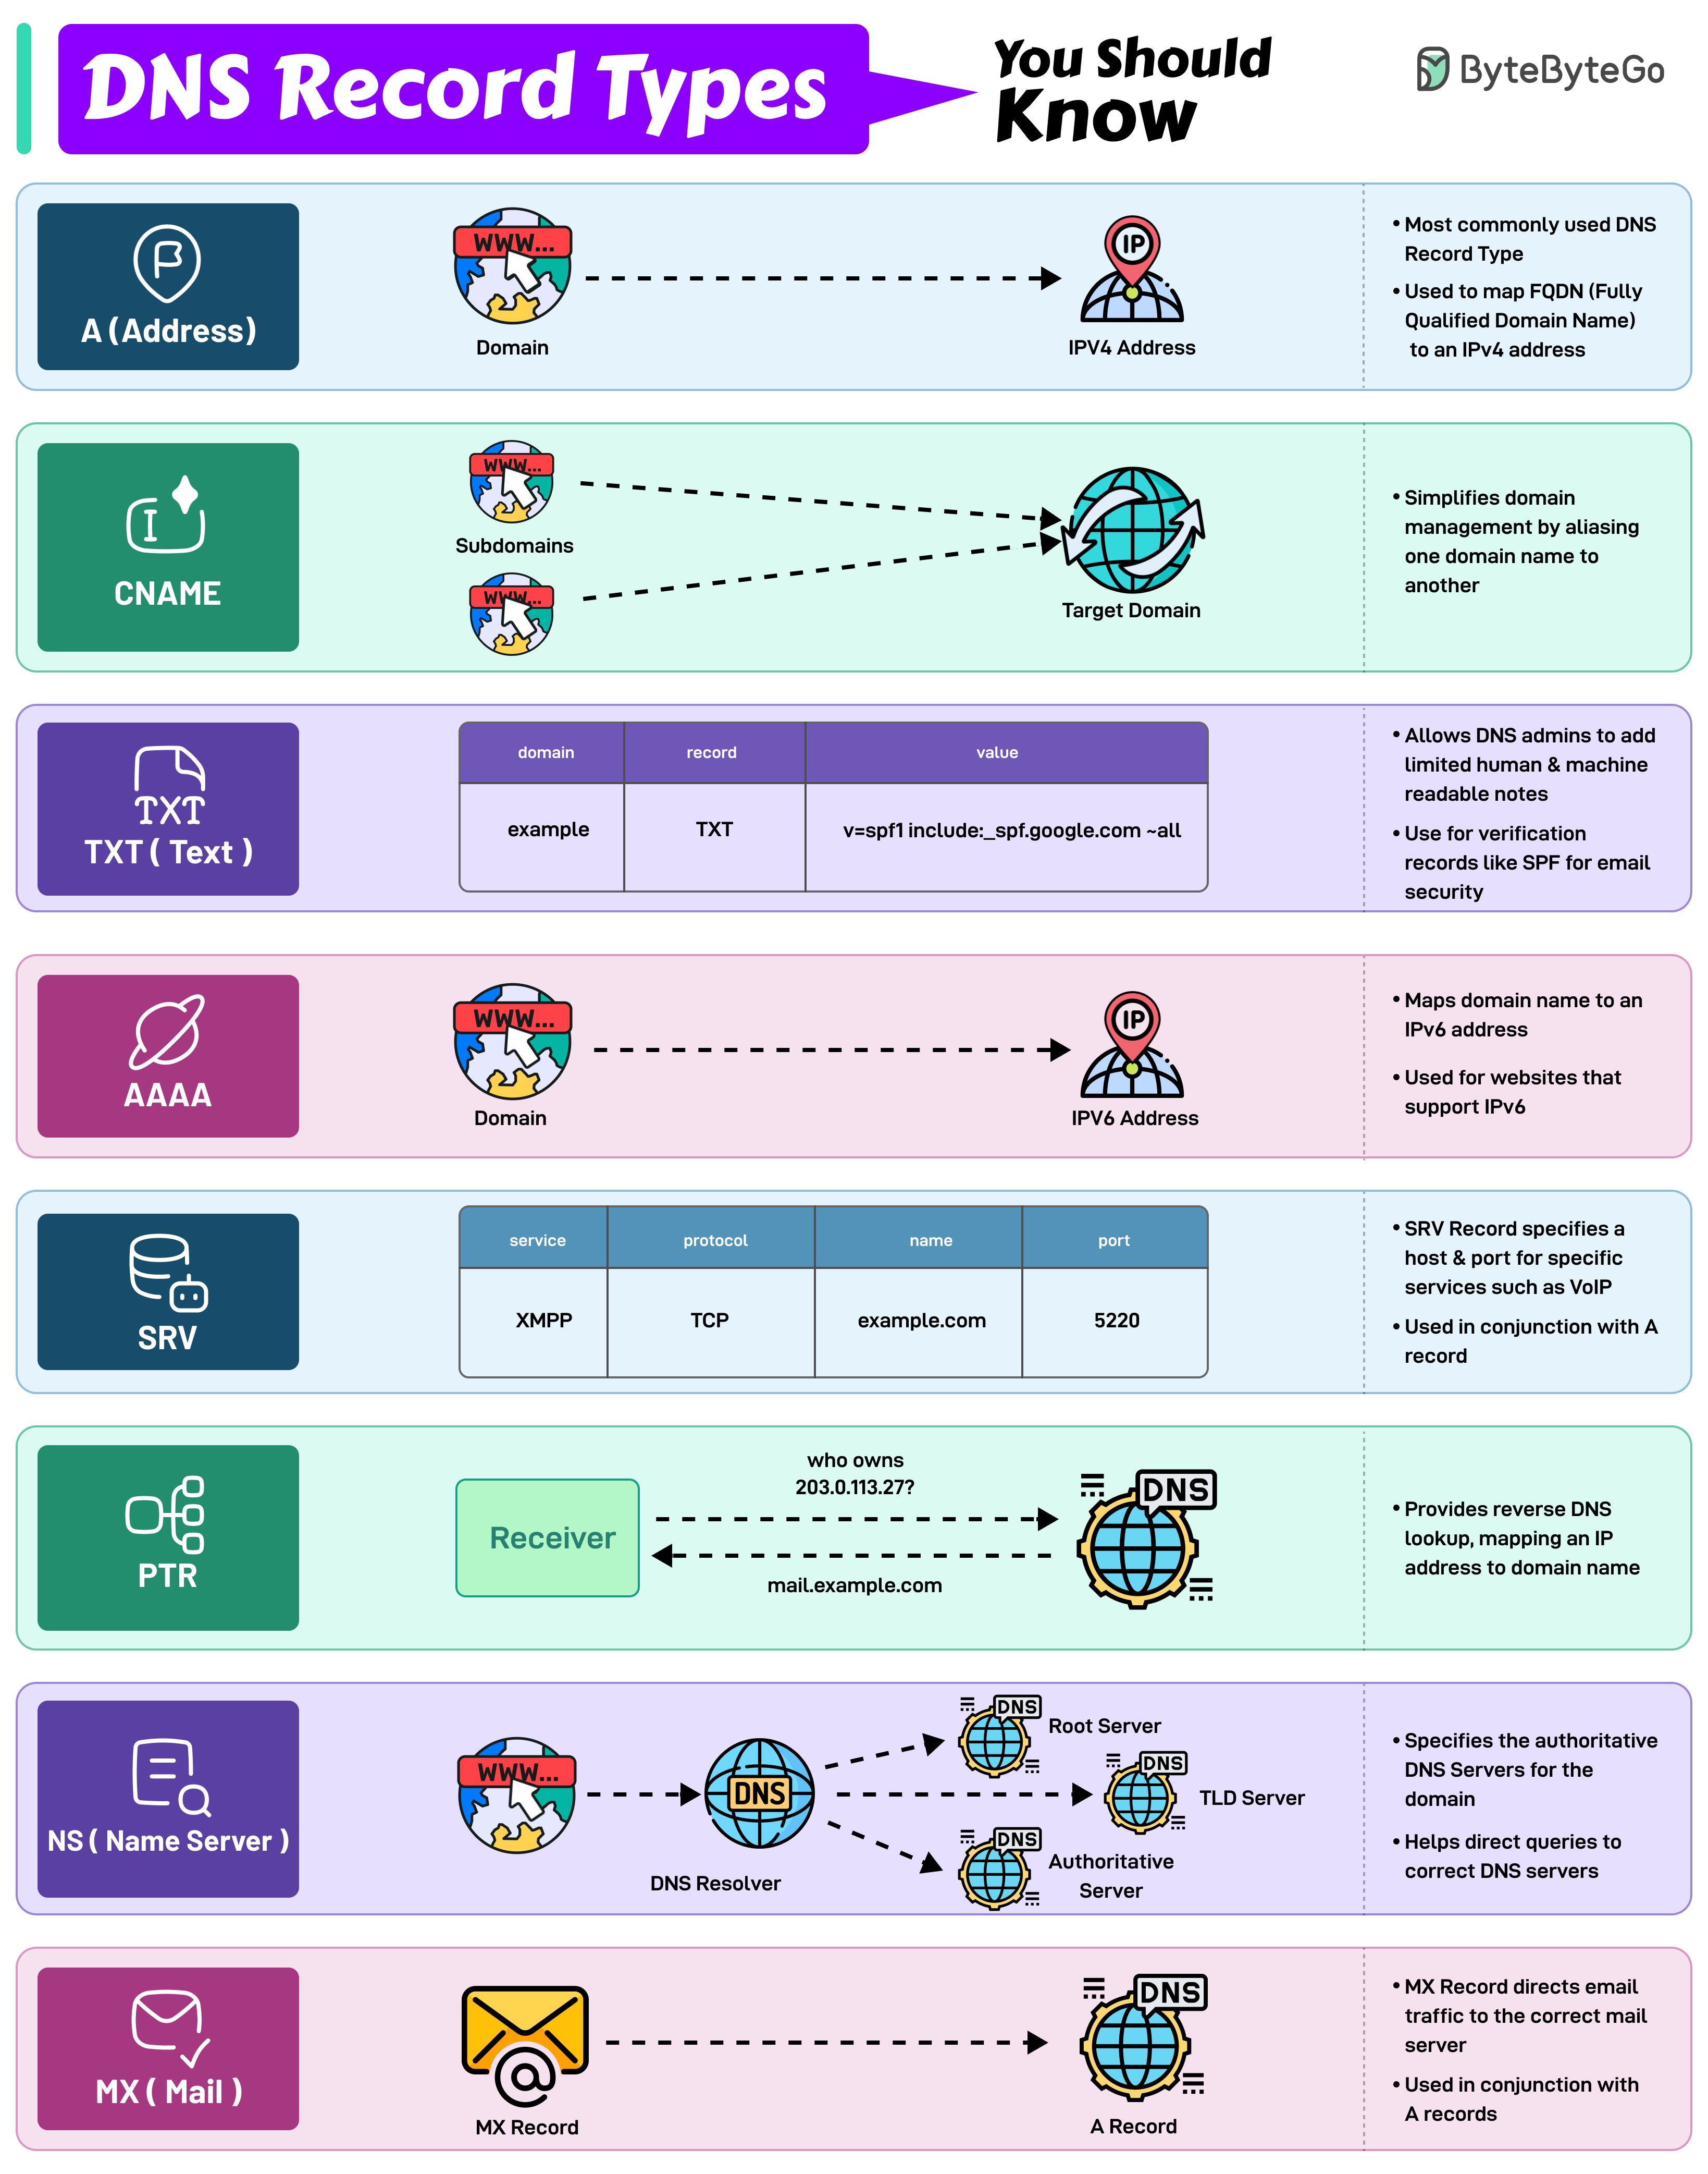
DNS RECORD
Information that tells DNS where a domain should go and what services it uses.

Slide 5
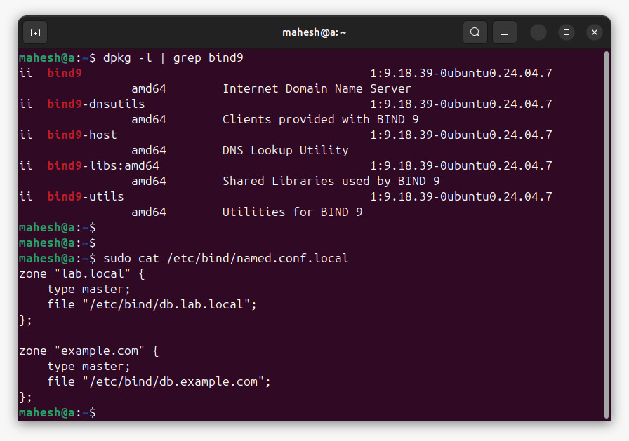
Package | Purpose
bind9 | Main BIND9 DNS server
bind9-dnsutils | DNS client/testing utilities
bind9-host | Provides the host DNS lookup command
bind9-libs | Libraries required by BIND9
bind9-utils | Administration and diagnostic utilities
"Which DNS zones should this server manage, and where are their zone files located?"

Slide 6
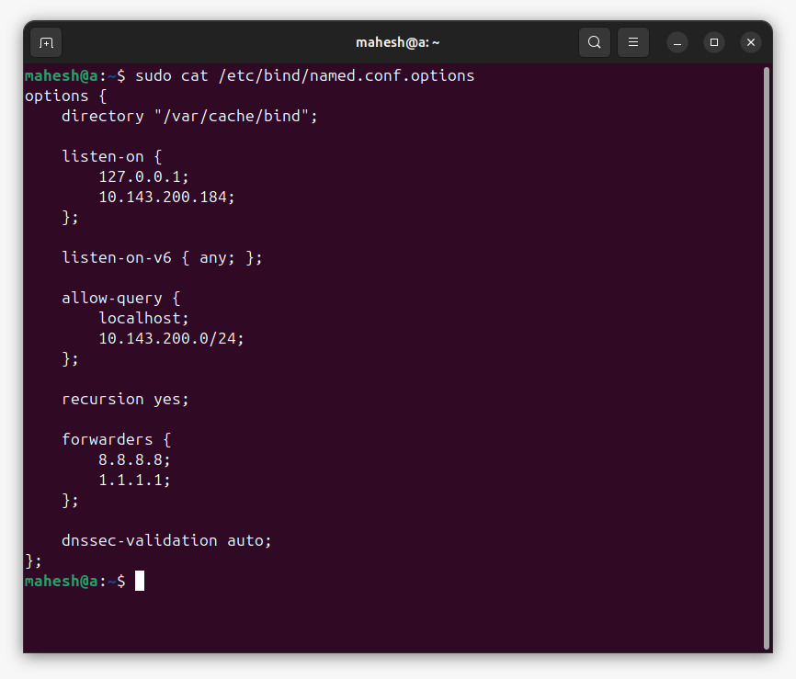
Configuration | Purpose
listen-on | Defines IPv4 addresses where BIND accepts DNS requests
listen-on-v6 | Enables IPv6 DNS listening
allow-query | Restricts which clients can send DNS queries
recursion yes | Allows recursive DNS resolution
forwarders | Sends external DNS queries to upstream resolvers
dnssec-validation auto | Enables automatic DNSSEC validation
directory | Defines BIND's working/cache directory
localhost/loopback address
BIND listens for DNS requests on:
IP address of your DNS server.
This controls who is allowed to send DNS queries to your server.
Google Public DNS.
Cloudflare Public DNS
DNSSEC helps verify that DNS responses are authentic and have not been tampered with.

Slide 7
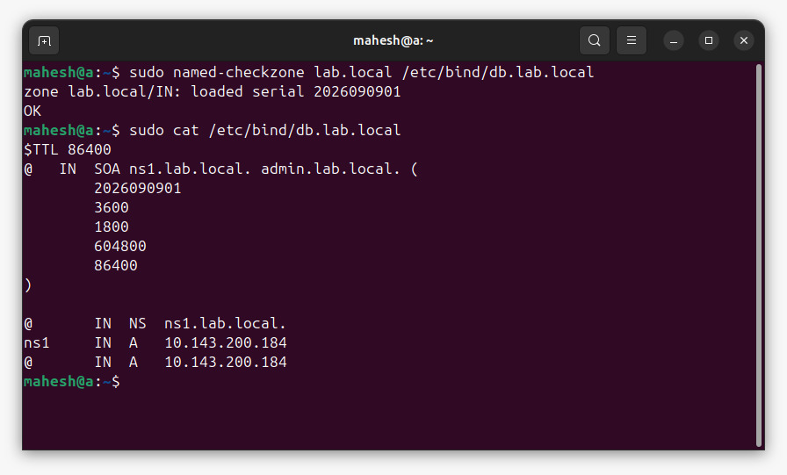
Value | Meaning | Time
3600 | Refresh | 1 hour
1800 | Retry | 30 minutes
604800 | Expire | 7 days
86400 | Negative caching | 24 hours
Time To Live (24 hr)
Start of Authority record.
Record | Purpose
SOA | Defines zone authority and administrative information
NS | Specifies the authoritative name server
A | Maps hostname/domain to IPv4 address
TTL | Defines DNS caching duration

Slide 8
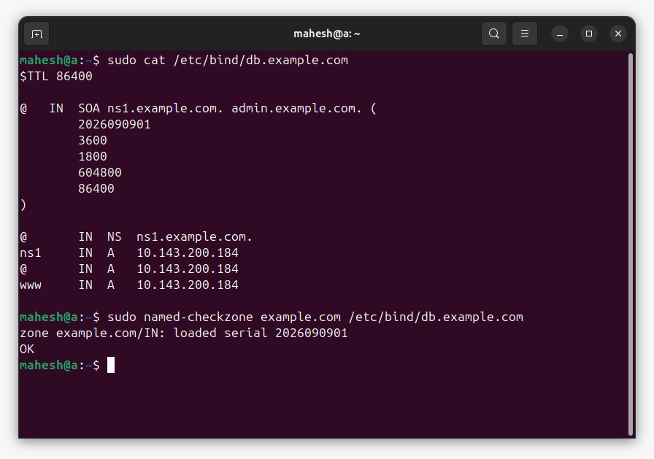
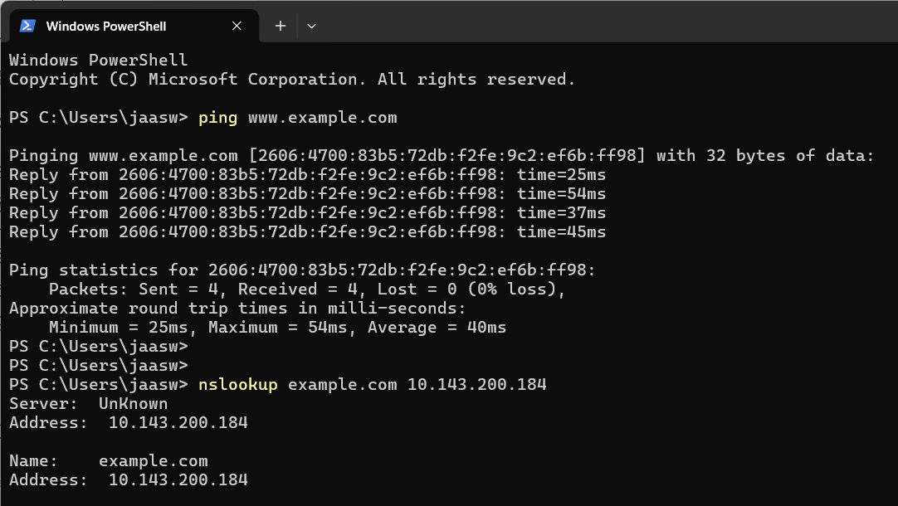

Slide 9
CDN = Content Delivery Network.
Protocol | Port
HTTP | 80
HTTPS | 443
A CDN is a distributed network of servers located in different geographical locations that delivers website content to users from a server that is physically closer to them.
A POP is a physical location/data center where a CDN has its edge servers.
A CDN POP can contain:
Edge servers
Caching systems
Network equipment
High-speed internet connections
Security/networking infrastructure
Edge server = server inside that location

Slide 10
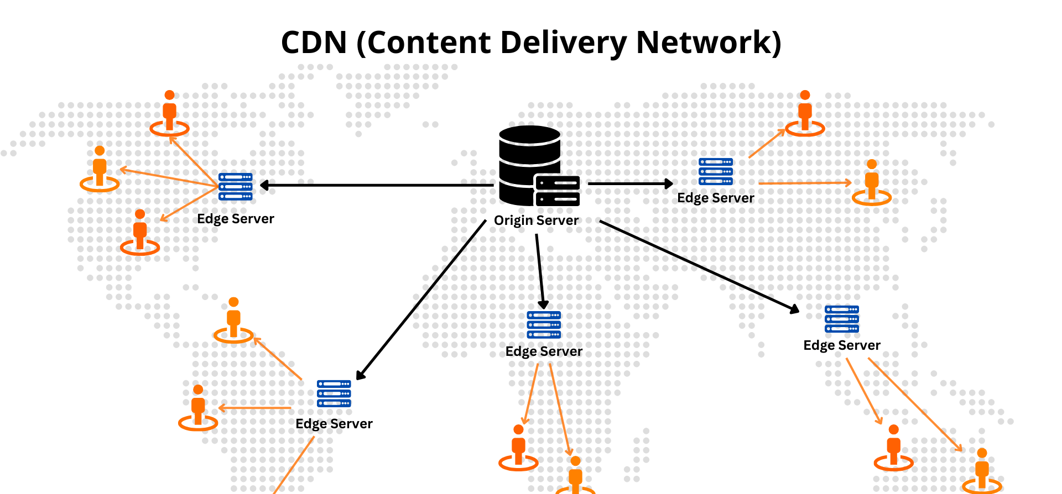
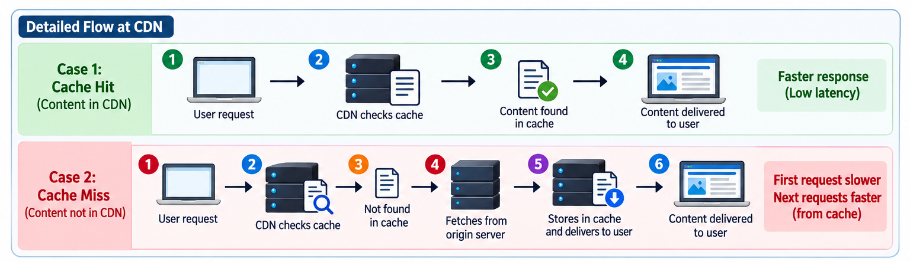

Slide 11
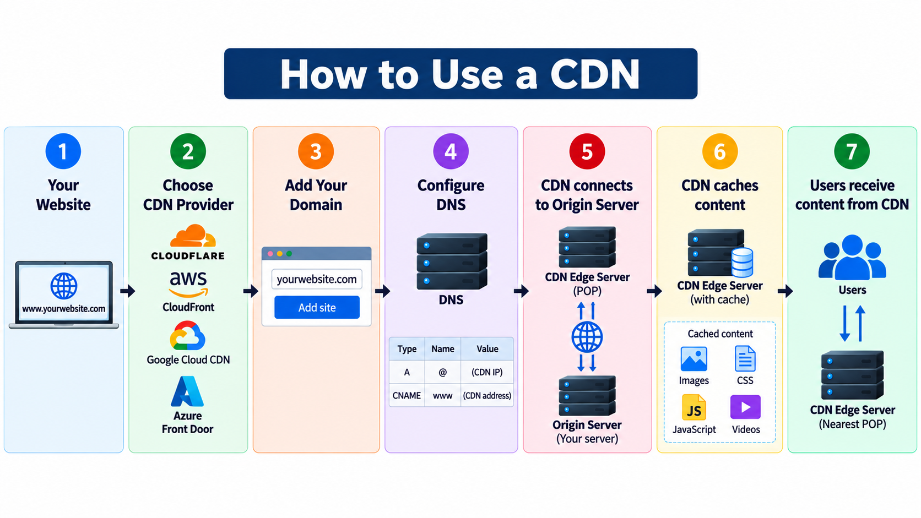

Slide 12
